Slide 1


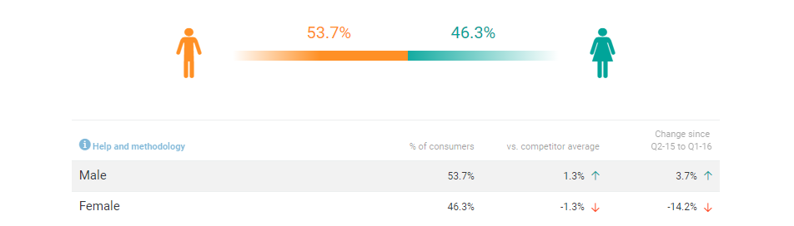
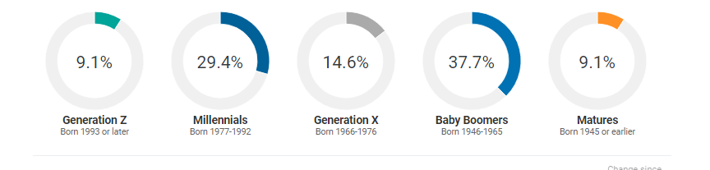

About Consumer Tracking
Ratings Identify operator strengths and weaknesses based on attribute ratings
Competition Know other players in the market and find lost business based on the consumer consideration set
Brand Mentions Use social listening to engage with influencers and tap into the buzz around brands
Visit Occasions Understand consumers’ characteristics and what drives their visits.
Menu Items See what items consumers purchase most
Download Get PowerPoint presentations of your data with a click of a button
CBM utilizes 140,000 consumer foodservice visits each year for 200 brands
| technomic.com

Slide 2
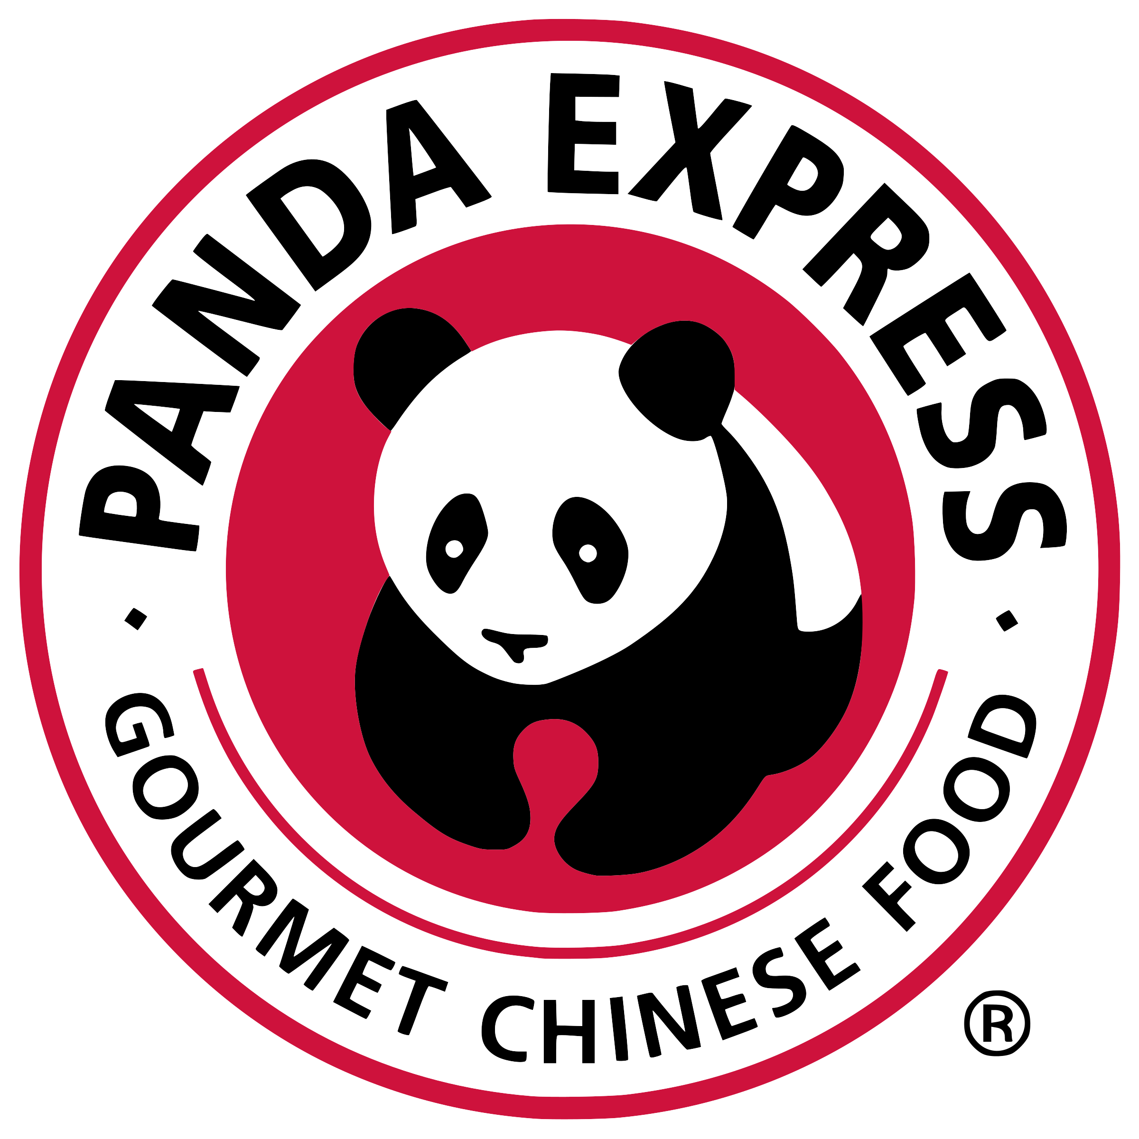
Top-Line Competitive Brand Assessment
KPI Stats
April 2019
Powered by Consumer Brand Metrics

Slide 3


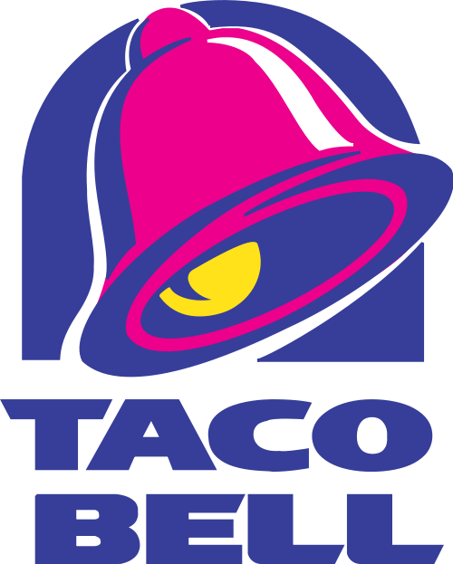

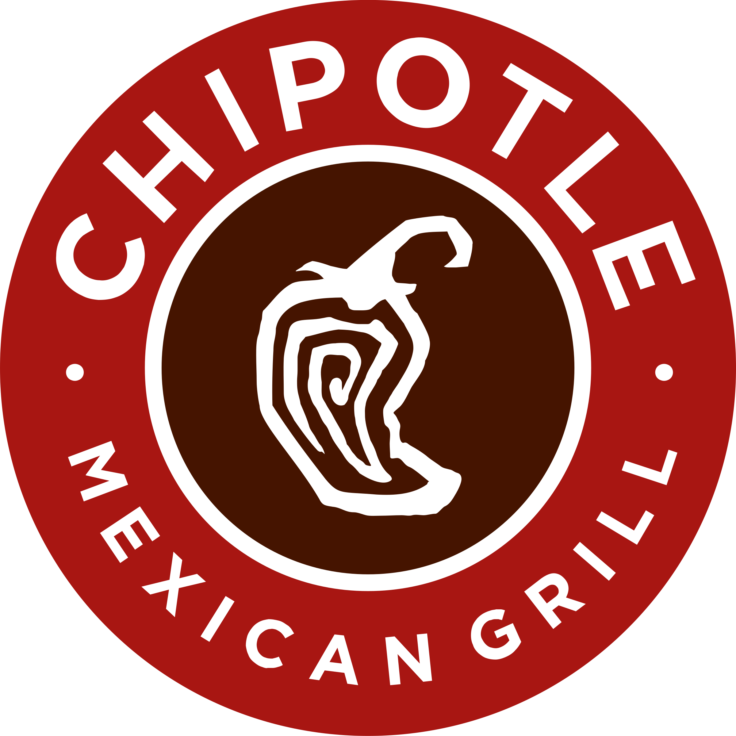

Top Panda Express Competitors
54.0% would have gone to another restaurant as an alternative to Panda Express
10.1% of recent Panda Express guests considered visiting McDonald's
7.4% considered visiting Subway7.4% considered visiting Subway
6.9% considered visiting Taco Bell
5.3% considered visiting Wendy's
4.2% considered visiting Chipotle Mexican Grill
4.0% considered visiting Burger King
Total base: 700 recent Panda Express guests (Q3 - Q2'18)

Slide 4
Panda Express Frequent Guest Demographic Skews
Female
Millennials
Caucasian
$50K - $75K
50.8% Of Panda Express's frequent guest are Female compared to 45.2% across all FCRs
38.9% Of frequent guest are Millennials compared to 46.6% across all FCRs
44.8% Of frequent guest are Caucasian compared to 59.6% across all FCRs
23.0% Of frequent guest are $50K - $75K compared to 21.7% across all FCRs
Frequent guest = consumers that visit the chain once a month or more Base: 18,711 once a month+ fast casual consumers (Q3 – Q2‘18)

Slide 6
Food Attributes
Food Taste & Flavor
Food Quality
Based on your recent visit, how would you rate the chain on _________? Total base: 700 recent guests per brand (Q3 – Q2‘18) Showing percentage selecting “very good” (top-box rating)

Slide 7
Most Craveable Panda Express Items
541 recent Panda Express guests who rated the chain as "good" or "very good" for craveable items"

Slide 8
Accuracy Attribute
Order Accuracy
Based on your recent visit, how would you rate the chain on _________? Total base: 700 recent guests per brand (Q3 – Q2‘18) Showing percentage selecting “very good” (top-box rating)

Slide 9
Cleanliness Attributes
Cleanliness of Dishware and Silverware
Interior Cleanliness
Kitchen or Food Prep Area Cleanliness
Based on your recent visit, how would you rate the chain on _________? Total base: 700 recent guests per brand (Q3 – Q2‘18) Showing percentage selecting “very good” (top-box rating)

Slide 10
Overall Visit Satisfaction
Based on your recent visit, how would you rate the chain on _________? Total base: 700 recent guests per brand (Q3 – Q2‘18) Showing percentage selecting “very good” (top-box rating)

